Slide 1
Equation Stories I
Mr. Petersen’s Math 8 Class

Slide 2
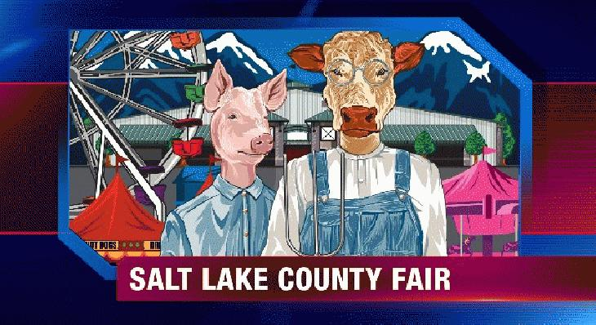
Going to the Fair

Slide 3
Going to the Fair
You go to the Salt Lake County Fair
The price of admission is $10.00, and each ride you go on is $3.00 per ride
Write an equation showing the amount of money you spend depending on how many rides you go on
If you go on 9 rides, how much will you spend?
If you spend $91.00 at the fair, how many rides did you go on?

Slide 4
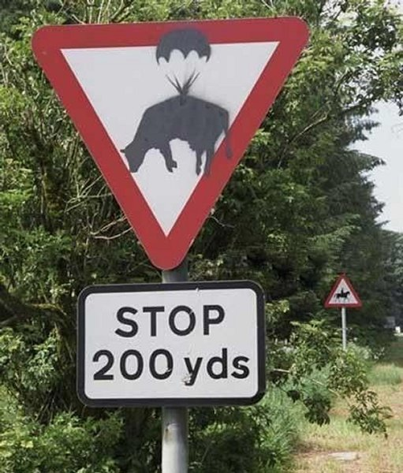
Cow Drop

Slide 5
Cow Drop
Please be cautious of parachuting cows for the next 200 yards
A cow is dropped from an airplane that is 500 feet in the air and falls at a rate of 6 feet per second
Write an equation showing the height of the cow depending on how many seconds it has been falling
How far is the cow off the ground after 30 seconds?
Approximately how long until the cow hits the ground?

Slide 6
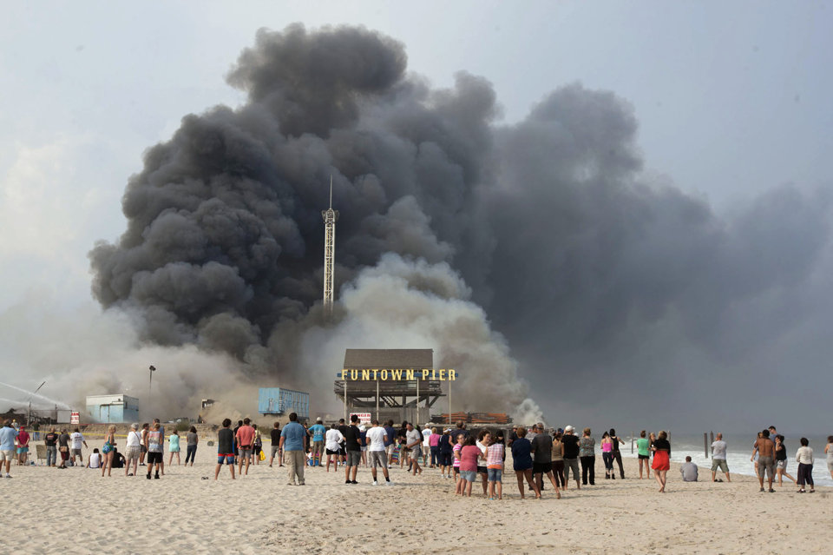
Jersey Shore Boardwalk Fire

Slide 7
Jersey Shore Boardwalk Fire
The Jersey Shore Boardwalk fire destroyed about 50 businesses over a stretch of about 3.2 miles
The fire spread across the boardwalk at about 0.05 miles per minute
Write an equation showing the distance the fire travelled depending on how many minutes it was blazing
How far had the fire gone in half an hour?
How long until the fire consumed all it would consume?

