Slide 1
Modeling Linear Situations with Graphs and Equations
Mr. Petersen’s Math 8 Class

Slide 2
Credit Card Point Systems

Slide 3
Credit Card Point Systems
You receive 3 points for every dollar you spend on your credit card
Make a graph showing this relationship

Slide 4
Fire Sale!

Slide 5
Fire Sale!
Run! It’s a fire!
…sale
You receive 30% off any purchase you make
Draw a graph showing how much you spend based on every dollar the items originally were

Slide 6
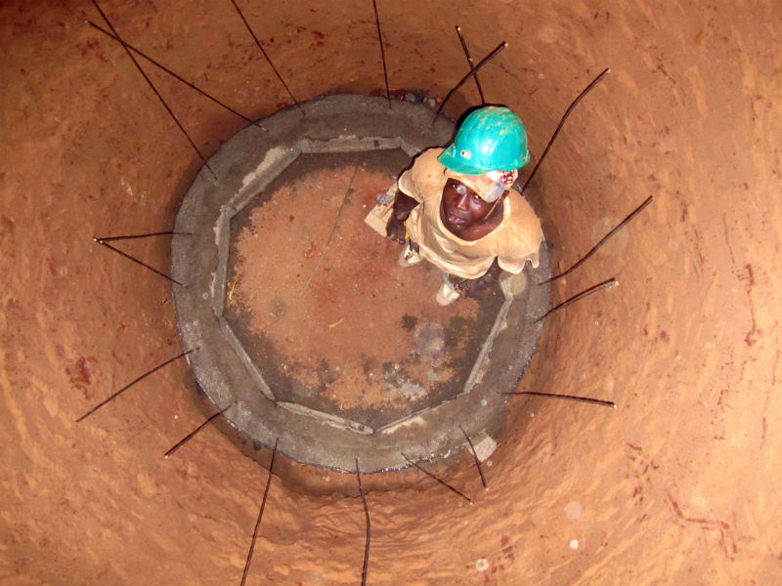
Digging a Well

Slide 7
Digging a Well
You are digging a well in a small village in Mexico so the people there can get fresh water
Suppose that you and your friends are able to dig 6 feet into the ground each hour
Draw a graph representing this situation
About how long until your well is 30 feet deep?

Slide 8
UFOs!

Slide 9
UFOs!
A UFO is climbing up into the sky at a rate of 10 feet each second
When will the UFO reach 12 yards high?
(1 yard is 3 feet)

Slide 10
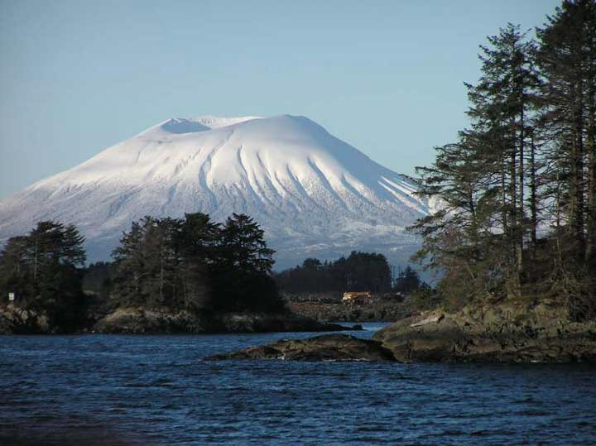
Sitka, Alaska

Slide 11
Sitka, Alaska
You are camping in Sitka, Alaska, and night is falling
The temperature is modeled by the graph to be drawn:
Write an equation showing the relationship between the temperature and time

Slide 12
Pet Adoption

Slide 13
Pet Adoption
Ana Cristina is holding a pet adoption fair
Every two hours, 7 pets are adopted
Graph this situation
How long until 27 animals are adopted?

Slide 14
WALKING

Slide 15
WALKING
Where are they walking?!
AAAARRRGGGHH
They started walking and someone made a graph to represent it
WHO MADE THAT GRAPH
AAAAARRRRGGHH
Turn that graph into an equation!
DO IT NOW
How long will it take them to walk 6 miles?

