Slide 1
Welcome to the best math class ever!
Math Rocks!
Ms. Luther

Slide 2
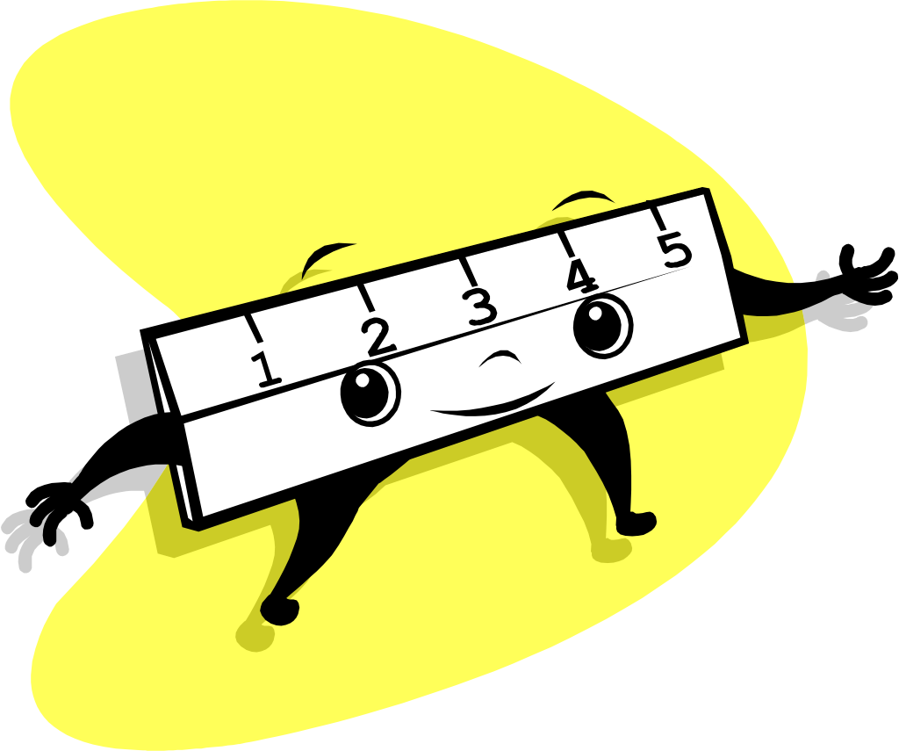
OUR CLASS WORK FOLDERS
Each of you has your own file
get your folder each day
Graphs will be kept in your folder.
SAGE graph
Grades graph
Citizenship: CPA
Grades: GPA
Math grade

Slide 3
. . . Folders. . .
Graphs:
attendance graph fill it in every day.
Math operations graphs
homework names and test scores.
Keep class work in folders.
When I hand back work, you may keep it in your file.
or you may keep it in your binder.

Slide 4
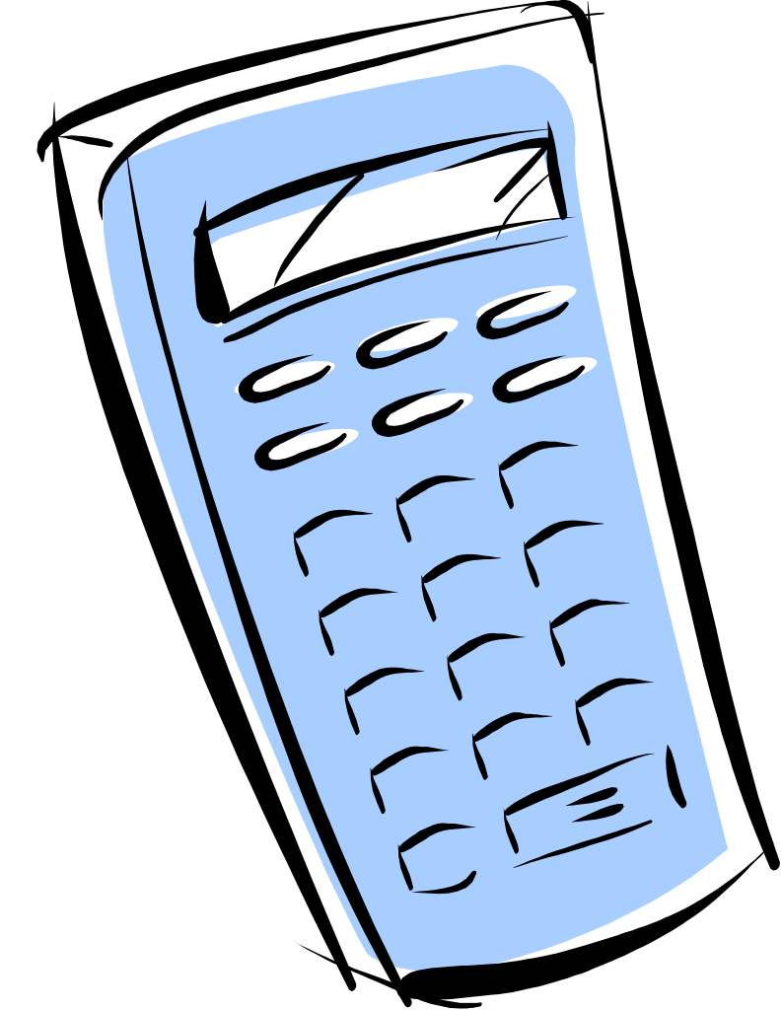
So, what should I bring to class each day?
School Planner
Three-ring binder
Lined paper
Pencil (that means no pens!)
Homework

Slide 5
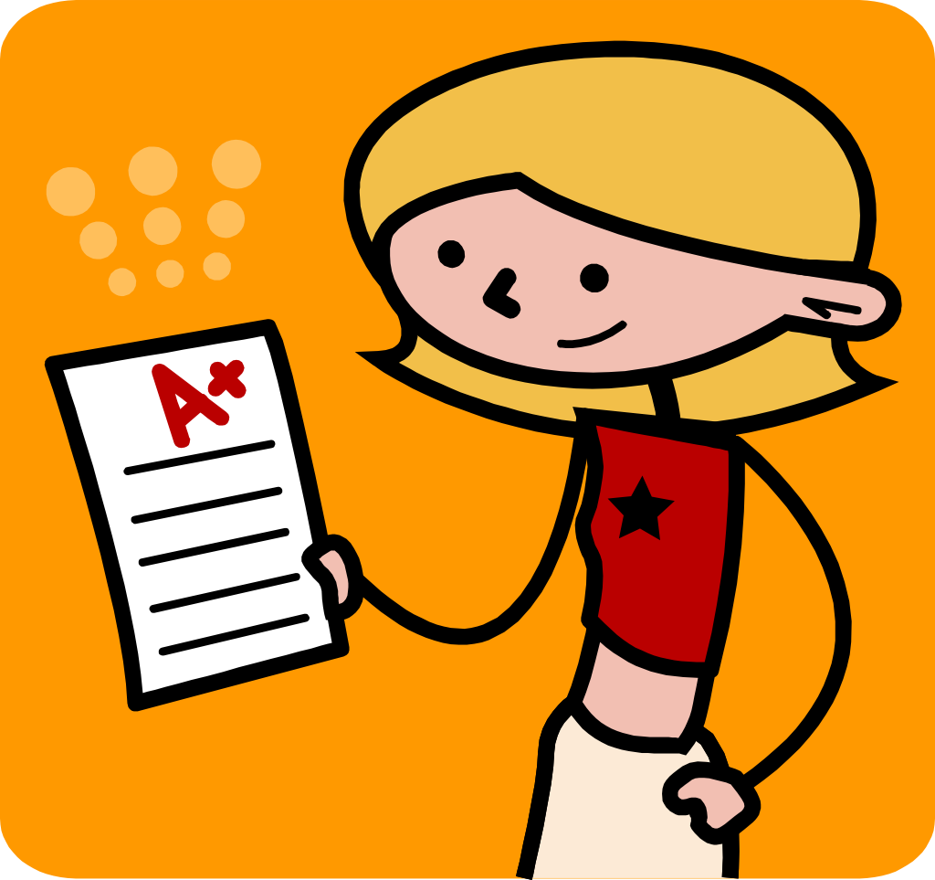
Okay, how do I get a good grade in this most awesome of math classes?
Grades are based on 4 areas:
Homework (digits, projects)
Tests
Classwork (notes worksheets, graphs)
Quizzes

Slide 6
Homework
Expect an Assignment every day.
HW is on DIGITS, online
You are responsible for keeping track of the assignments in your planner and graph.
Each assignment is worth 10 points.
Absent assignments are only accepted one week after they are given.
If you don’t bring your HW you will be sent to the office

Slide 7
HW
Write your math on a paper.
Every problem must be on the paper
Include your score
(must get 90% or better)
Must be written in pencil.
Be neat! Quality not Quantity.

Slide 8
In Class
Hand your HW to Mrs. Luther at the door.
Get your folder.
Get your starter.
Wait for the timer
GO! don’t worry about mistakes, just try
BE POSITIVE, no whining

Slide 9
Help! I need help! Who gets this math stuff anyway?
Outside of class help
Computer labs after school
All you have to do is ask.

Slide 10
I’m late! I’m late for a very important class!
Tardy policy
1st tardy – Name added to the tardy list.
2nd tardy – Student calls parent and lunch detention assigned.
3rd tardy –After School Detention (ASD)
4th tardy – 1 Day of In-School Suspension (ISS)
5th tardy – Overnight suspension – must return with a parent
6th tardy – Out of School Suspension (OSS) for 1 day, must return with a parent

Slide 11
Now for your first pop quiz (try not to panic)
Name one thing you must bring to class each day.
What must all assignments be written in?
What do you get at the beginning of class.
How often do you get an assignment?
True or false? Math is actually fun!

